Slide 1

McGraw-Hill Technology Education
Copyright © 2006 by The McGraw-Hill Companies, Inc. All rights reserved.

Slide 2
Chapter 1B
Looking Inside the Computer System

Slide 3
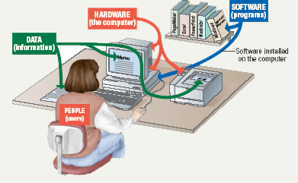
Parts of the Computer System
Computer systems have four parts
  Hardware
  Software
  Data
  User
1B-<number>

Slide 4
Parts of the Computer System
Hardware
  Mechanical devices in the computer
  Anything that can be touched
Software
  Tell the computer what to do
  Also called a program
  Thousands of programs exist
1B-<number>
Notes:
Teaching tip
Suggest to your students that the majority of people who purchase computers do so because of software. They want to email, or type letters. Nearly every reason given to purchase a computer is based on software needs.

Slide 5
Parts of the Computer System
Data
  Pieces of information
  Computers organize and present data
Users
  People operating the computer
  Most important part
  Tell the computer what to do
1B-<number>
Notes:
Teaching tip
A good exercise to relate the importance of making data meaningful is to list some random numbers on the board. Then ask what they mean. Without a title, the numbers have no meaning. Once a title is presented, the numbers make sense.

Slide 6
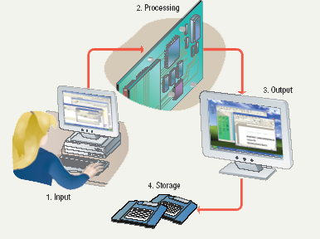
Information Processing Cycle
Steps followed to process data
Input
Processing
Output
Storage
1B-<number>
Notes:
Teaching tip
It is helpful to walk through a simple program to demonstrate the cycle. I often use a simple arithmetic problem to show this cycle.

Slide 7
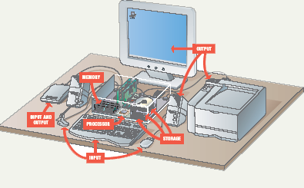
Essential Computer Hardware
Computers use the same basic hardware
Hardware categorized into four types
1B-<number>

Slide 8
Essential Computer Hardware
Processing devices
  Brains of the computer
  Carries out instructions from the program
  Manipulate the data
  Most computers have several processors
  Central Processing Unit (CPU)
  Secondary processors
  Processors made of silicon and copper
1B-<number>
Notes:
Teaching tip
The interaction between a CPU and secondary processors is much like the interaction between a boss and subordinate. The boss tells the subordinate what to do but not necessarily how to accomplish the task. The subordinate only bothers the boss when guidance or more data is needed.

Slide 9
Essential Computer Hardware
Memory devices
  Stores data or programs
  Random Access Memory (RAM)
    Volatile
    Stores current data and programs
    More RAM results in a faster system
  Read Only Memory (ROM)
    Permanent storage of programs
    Holds the computer boot directions
1B-<number>
Notes:
Insider information
Intel, the manufacturer of popular CPUs, originally made RAM for mainframe and minicomputers. Today Kingston is a leading RAM manufacturer.
Chapter 5 discusses ROM and the BIOS. Refer your students to this chapter if they desire more information.

Slide 10
Essential Computer Hardware
Input and output devices
  Allows the user to interact
  Input devices accept data
    Keyboard, mouse
  Output devices deliver data
    Monitor, printer, speaker
  Some devices are input and output
    Touch screens
1B-<number>
Notes:
Teaching tip
It is helpful to have examples of input and output devices in class. Stories of obscure input output devices are typically well received by the students.

Slide 11
Essential Computer Hardware
Storage devices
  Hold data and programs permanently
  Different from RAM
  Magnetic storage
    Floppy and hard drive
    Uses a magnet to access data
  Optical storage
    CD and DVD drives
    Uses a laser to access data
1B-<number>
Notes:
Insider information
A new CD technology is emerging. A shorter wavelength blue laser beam is being used to burn CD’s. This allows more data to be saved on a disk. The technology is in it’s infancy but should be mature in the near future.
Chapter 11 of the text provides more detail regarding storage devices.
DVD writers are available for purchase. They have not been standardized yet. Several competing formats are vying for acceptance. Of these, the DVD+RW seems to have the strongest support.

Slide 12
Software Runs the Machine
Tells the computer what to do
Reason people purchase computers
Two types
  System software
  Application software
1B-<number>

Slide 13
Software Runs the Machine
System software
  Most important software
  Operating system
    Windows XP
  Network operating system (OS)
    Windows Server 2003
  Utility
    Symantec AntiVirus
1B-<number>

Slide 14
Software Runs the Machine
Application software
  Accomplishes a specific task
  Most common type of software
    MS Word
  Covers most common uses of computers
1B-<number>

Slide 15
Computer Data
Fact with no meaning on its own
Stored using the binary number system
Data can be organized into files
1B-<number>
Notes:
Teaching tip
Chapter 5 in the text explores data processing in greater detail.
Figure 1B.5 shows data in binary format.

Slide 16
Computer Users
Role depends on ability
  Setup the system
  Install software
  Manage files
  Maintain the system
“Userless” computers
  Run with no user input
  Automated systems
1B-<number>
Notes:
Teaching tip
Most computer problems are caused by user error. Given this fact, it is fun here to teach the student the acronym PEBKAC the Problem Exists Between Keyboard And Chair. A little humor can break up the lecture monotony.

Slide 17
Chapter 1B
End of Chapter

